Slide 1



Water Management using
Digital Twins

Slide 2


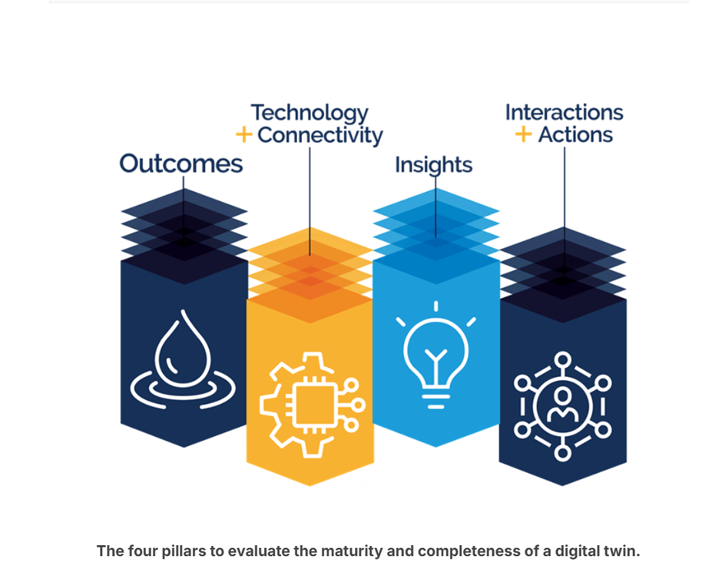
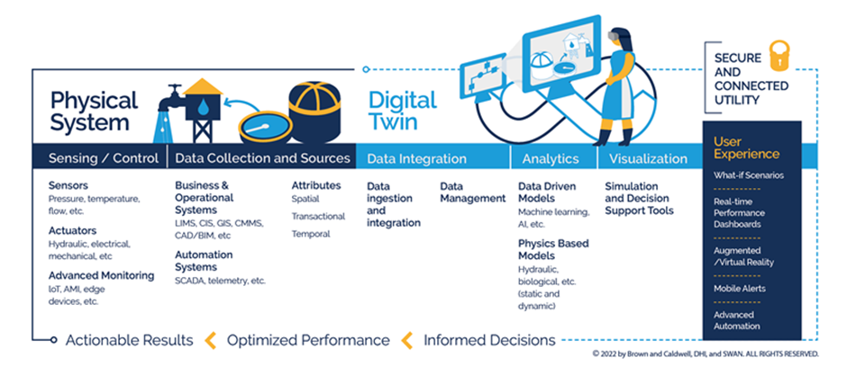
Introduction to Digital Twins
Digital Twin Overview: A digital twin is a dynamic virtual replica of a physical system that enables continuous real-time simulation and analysis. It integrates sensor data, mathematical models, and AI to bridge the physical and digital worlds. In smart water systems, digital twins allow continuous monitoring and intelligent control of infrastructure (pipes, pumps, tanks), supporting predictive maintenance and optimized operations
4 MAIN PILLARS OF DIGITAL TWIN
ARCHITECTURE:
SWAN Digital Twin Architecture diagram gives a framework for categorising a digital twin’s main elements. This architecture framework can function as a checklist and lets you see the components and gaps you have to complete your digital twin.

Slide 3
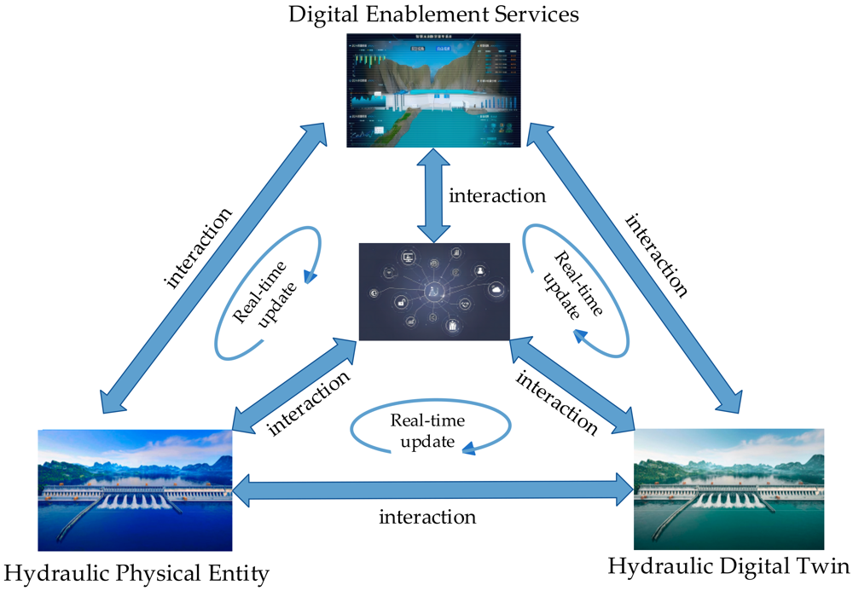
Traditional vs Digital-Twin Models
Traditional Water Management: Relies on offline simulations and historical data (GIS/BIM, hydrological models) with manual updates, mainly used during planning and design. Limited to static, 2D models and periodic analysis.
Digital Twin Approach: Uses real-time IoT sensor data and AI-driven models for ongoing, automated system management. Covers the full life cycle (planning through operation) with multi-dimensional, high-fidelity 3D models. Models are continuously validated and updated against live data, enabling closed-loop control and decision-making.
Key Differences: Traditional models require manual recalibration and have fixed scope, whereas digital twins are scalable (standardized interfaces) and enable seamless integration of new data sources and services.
Five-Dimensional Digital Twin Model
Smart Water 5D Model: The digital twin for smart water conservancy includes five dimensions – physical entity, virtual model, data, service, and connection – adapted for water systems. Specifically, it comprises the physical water infrastructure (dams, pipes, watershed), its virtual twin model, spatiotemporal perception data (ground, aerial, satellite sensors), ubiquitous real-time interactions, and a digital service layer (analytics/control). This 5D framework supports detailed simulation, visualization and iterative optimization of water systems.

Slide 4
Water Conservancy Physical Entity:
Real-time data from physical water conservancy infrastructures (topography, equipment, construction impact areas) are collected using integrated air, sky, and ground monitoring systems. These include IoT sensors and devices feeding data into digital twin systems.
• Water Conservancy Digital Twin:
A comprehensive virtual model of the water conservancy system is built using geometric, analytical, statistical, behavioral, and visualization models to represent the physical entity dynamically across multiple dimensions and time scales.
• Heaven, Earth, and Space Perception Data:
Sensor-collected data, essential for digital twin operations, may have errors due to environmental influences and transmission loss. Thus, preprocessing and data fusion techniques are required for accuracy and integration.
• Ubiquitous Real-Time Interaction:
A networked infrastructure (including IoT, internet, control systems, and protocols) enables real-time, secure, and efficient data exchange between physical systems and their digital counterparts for collaborative and optimized control.
• Digital Empowerment Services:
Application layer of the digital twin system serving various stakeholders (authorities, operators, public) with solutions in water resource management, flood control, project monitoring, and risk early warning.

Slide 5
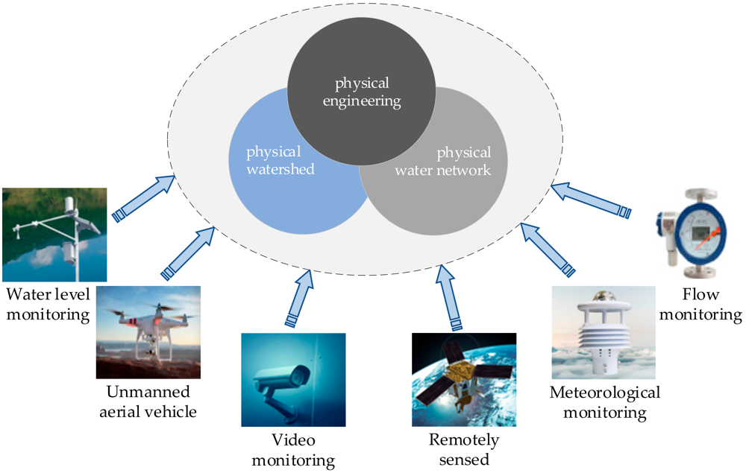






Key Components
Sensors and Data Collection
IoT Connectivity
Sensor data are transmitted via wireless/Internet links to a cloud/edge platform for processing. Networking (LPWAN, LORA, etc.) ensures continuous data flow.
Gathering Essential Information
Diverse IoT sensors (e.g. flow meters, level gauges, weather stations, drones) collect real-time data on water levels, flow rates and qualitymdpi.com.
AI & Analytics
Cloud/Edge Computing
Machine learning and data-mining algorithms
Provides scalable storage and processing (big data, edge nodes) for high-fidelity digital twin models
Analyze the data for anomaly detection, demand forecasting, and decision support
Data processing ensures timely decision-making and operational efficiency.
Visualization Tools
Integration Platforms: BIM/GIS integration and APIs connect diverse models, enabling 3D visualization and real-time control.

Slide 6


Real-Time Data Flow and Control
Continuous Monitoring: IoT sensors feed live data into the digital twin, giving up-to-the-second awareness of the campus water system’s state.
Analytics & Predictions: Real-time data drive AI models that detect leaks, predict usage, and forecast events (e.g. leakage). For example, a pressure drop triggers the twin to localize a leak and recommend action.
Feedback Control: The twin can command actuators (valves, pumps) via control systems to adjust flows or isolate faults automatically.
Operator Interface: Dashboards and alerts help operators oversee water use and respond to issues quickly.
Iterative Optimization: Continuous data-model feedback (“twinned data”) enables iterative improvement of system performance over time.

Slide 7
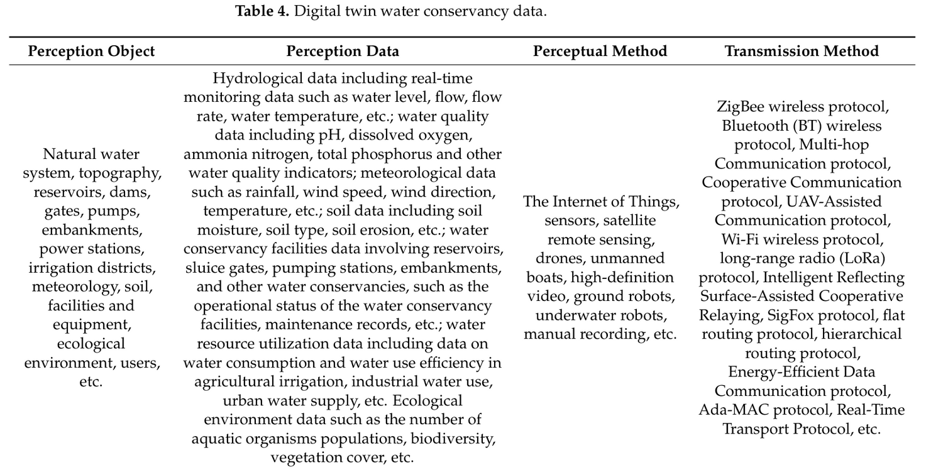
Data Collection & Transmission in Digital Twin Water Systems
1. Perception Layer (Data Collection)
Perception Objects:
Natural water bodies, reservoirs, dams, pumps, irrigation systems, weather, ecology, infrastructure, users.
Types of Perception Data:
Hydrology: water level, flow rate, temperature.
Quality: pH, dissolved oxygen, ammonia, etc.
Meteorology: rainfall, wind, temperature.
Soil: moisture, erosion, salinity.
Infrastructure: pump/gate states, maintenance logs.
Ecology: biodiversity, vegetation cover.
Methods:
IoT sensors, satellite imagery, drones, robots, video, manual logs.

Slide 8
Real-Time Data Transmission Challenges & Solutions
Challenges:
Congestion, latency, data loss, energy consumption.
Solutions:
Ada-MAC: Low-power, real-time protocol based on IEEE 802.15.4.
Multipath Routing: Selects optimal paths based on live network quality.
EEDC Protocol: Efficient long-distance data transfer using short-hop routing.
Congestion-Adaptive Compression: Balances data fidelity vs. transmission load.
RTP-Based Estimation: Mitigates packet loss and timing issues in control systems.
2. Transmission Layer
Key Requirements:
Low latency, high reliability, energy efficiency.
Supports real-time updates for the digital twin.
Transmission Technologies:
ZigBee, Bluetooth, LoRa, Wi-Fi, UAV-assisted, Ada-MAC, RTP, etc.
Hierarchical routing and multipath protocols to enhance robustness.

Slide 9
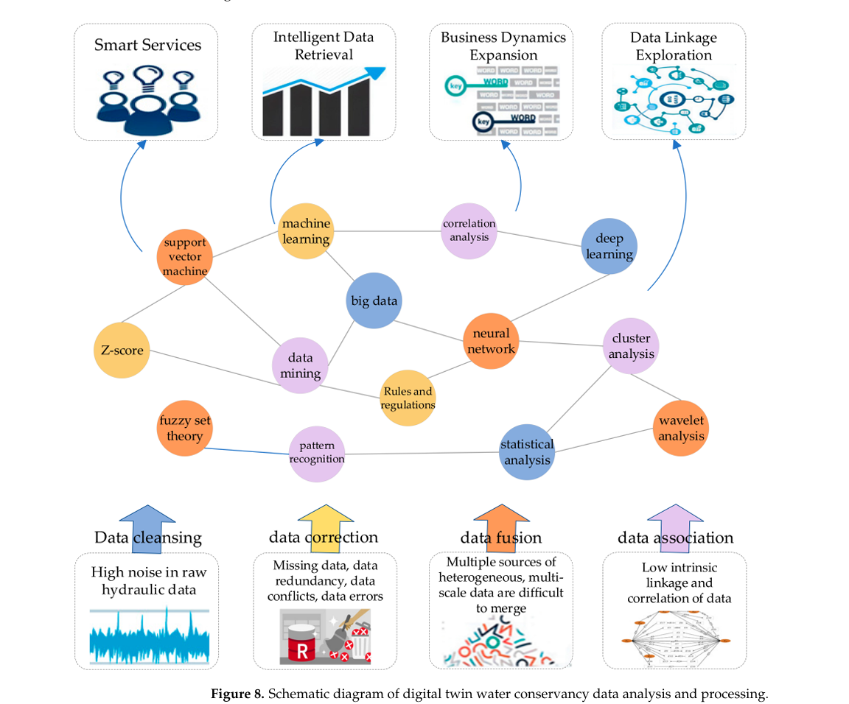
Digital Twin Data Analysis & Processing
Challenges with Sensor Data:
Data is multi-source, heterogeneous, multi-scale, and noisy.
Issues include missing data, redundancy, conflicts, and errors.
Step-by-Step Processing Pipeline:
Data Cleaning & Standardization
Algorithms: Rule-based systems, machine learning.
Purpose: Improve consistency, remove redundancy/conflicts.
2.Multi-Sensor Data Fusion
Methods:
Fuzzy logic
Neural networks
Wavelet analysis
Support Vector Machines (SVMs)
Outcome: Robust, unified datasets → accurate virtual model behavior.
3.Feature Extraction & Model Mapping
Tools: IoT middleware, semantic fusion.
Example: Combine CAD + CAM system features to form digital models.

Slide 10
4. High-Volume Data Handling
Data too large for personal systems → Use:
Cloud computing
Parallel processing (e.g., MapReduce)
5. Data Mining for Insights
Uncover system-wide relationships and decision rules using:
Statistical analysis
Machine learning
Pattern recognition
Applications:
Predict construction progress
Analyze hydrology/water quality at scale
Identify leakage risks
Optimize energy use and infrastructure planning
Goal:
Enhance model accuracy, reliability, and real-time applicability to support water-related decision-making across campus.

Slide 11
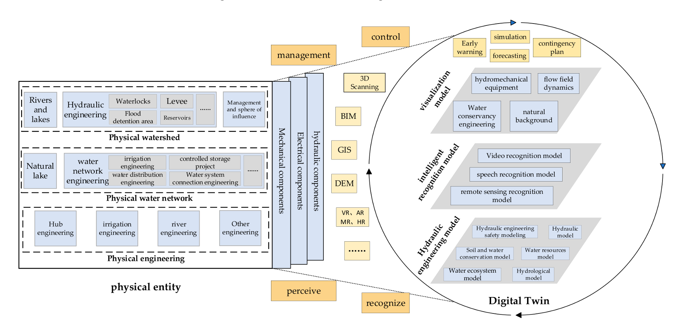
Digital twin smart water conservancy full-factor model.

Slide 12
Virtual–Real Interaction in Digital Twins
· - Digital twins rely on virtual–real interaction: the virtual model monitors and simulates the physical system, then executes control commands in the real world
· Types of Interaction:
· - Physical–Physical: Devices collaborate and coordinate to perform tasks.
· - Virtual–Virtual: Multiple digital models interact in a shared virtual space.
· - Physical–Virtual: Two-way synchronization; virtual models adapt based on real-time data and can control physical devices.
· 4D Convergence Framework:
· - Physical Convergence: Real-time control of physical devices via IoT protocols.
· - Model Convergence: Integration of simulation and predictive models.
· - Data Convergence: Real-time fusion of sensor, model, and simulation data.
· - Service Convergence: Twin data analytics influence decision-making and operations.
· Technologies Involved:
· - Intelligent sensing, distributed control, real-time data fusion, human-computer interaction.
· Goal:
· - Achieve intelligent, flexible, and autonomous control in smart water systems.

Slide 13
Digital Twin Water Conservancy: Service Applications
· Purpose:
· - Enable smarter water management through data-driven, scenario-specific applications.
· Key Applications:
1. Water Resource Management & Allocation
· - Optimize pressure valves, detect leaks using digital twin models.
· - Boost water efficiency and energy savings.
2. Early Warning Systems
· - Use machine learning + real-time data to dynamically adjust stormwater infrastructure.
· - Simulate floods, forecast emergencies, and plan responses (e.g., Digital Twin Yangtze River).
3. Decision Support
· - Track pollutants, assess risks, manage urban/natural drainage systems.
· - Aid policymakers via real-time simulations and immersive 3D models.
4. Operation & Maintenance of Projects
· - Monitor equipment status using sensors.
· - Enable intelligent, automated, and reliable O&M services.
· - Example: Digital twin dam platforms combining AI, UAVs, GIS, and surveillance for watershed and flood management.

Slide 14
Campus Implementation Framework
· Architecture:
· - Install sensors/meters in key buildings and distribution points.
· - Connect via campus IoT network to a central digital twin platform.
· Model Construction:
· - Develop virtual models of campus buildings, water networks, and hydrological features using BIM/GIS to form the twin’s core.
· Data Integration:
· - Stream building and network data (flow, levels, pressures, weather) into the twin in real-time.
· - Use data lakes or time-series databases for storage.
· Software Stack:
· - Leverage cloud/edge computing with AI, big data analytics and possibly blockchain for data integrity.
· - Follows the “ABCDE” paradigm: AI, Blockchain, Cloud, Data, Edge.
· Control & Visualization:
· - Provide SCADA/MTU links for automated control.
· - Use 3D dashboards for operators to view live water flows and asset status.
· Modularity:
· - Design twin modules block-by-block (e.g. dormitory zone, lab zone).
· - Enables campus-wide scaling in phases.

Slide 15
Use Cases / Hypothetical Examples
· Leak Detection & Response:
· - Twin simulates campus water flows; a pressure drop detected in a dorm block triggers the model to pinpoint a leak location.
· - The system automatically closes a shutoff valve and alerts maintenance.
· Demand Forecasting:
· - AI within the twin predicts each building’s water demand pattern.
· - Pumps and storage are scheduled accordingly, reducing energy use during off-peak times.
· Quality Monitoring:
· - Water-quality sensors feed into the twin, which simulates pollutant dispersion.
· - If contamination is detected, the twin assesses impact zones and supports rapid mitigation.
· Event Impact Analysis:
· - The twin simulates scenarios (e.g. fire suppression use, drought) to help facility planners prepare contingency plans.
· Decision Support:
· - Provides campus managers with “what-if” scenario analysis (e.g. new construction added).
- Helps inform infrastructure investments

Slide 16
Implementation Steps for Campus Digital Twin Water Management
Define Objectives and Scope
Assess Existing Infrastructure and Data
Design the Digital Twin Architecture
Deploy and Integrate Sensors and IoT Devices
Develop and Calibrate the Virtual Model
Implement Real-Time Data Interaction and Control
Develop Analytics, Visualization, and Decision Support Tools
Pilot, Evaluate, and Iterate
Scale Up and Institutionalize

